Slide 1

GNU/Linux
Operating System
// SE1633
// OSG202

Slide 2
// Table Of Contents
01
History
02
03
Uses
04
Market share and uptake
Development

Slide 3
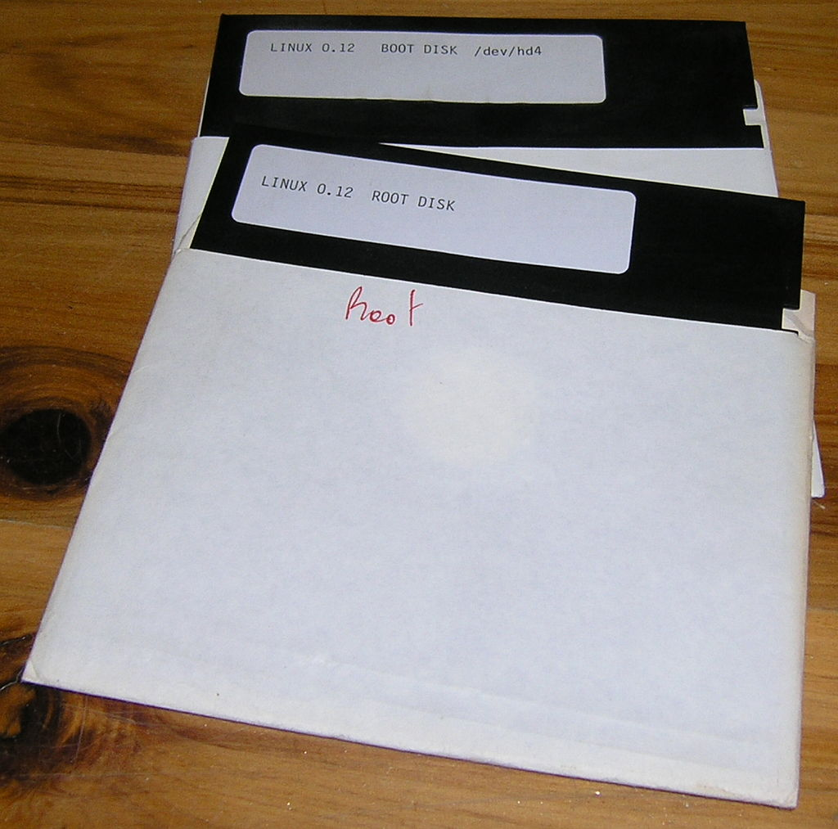
01
CENTER
// OUR
History
// Group 4

Slide 4

// Origin
GNU/Linux is a family of open-source Unix-like operating systems based on the Linux Kernel, an operating system kernel first released on September 17, 1991, by Linus Torvalds.

Slide 5
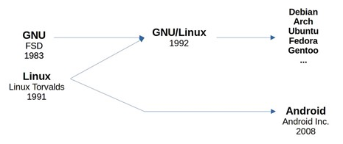
// Linux Kernel
Linux
GNU
Not an operating system but a kernel
Tools/Commands to interact with Linux Kernel
Ex: cd, ls, cat, …
Android
Linux Kernel with Google Toybox

Slide 6
// Name
Free + Freak + Unix Freak
Linus + Unix Linux
GNU/Linux

Slide 7
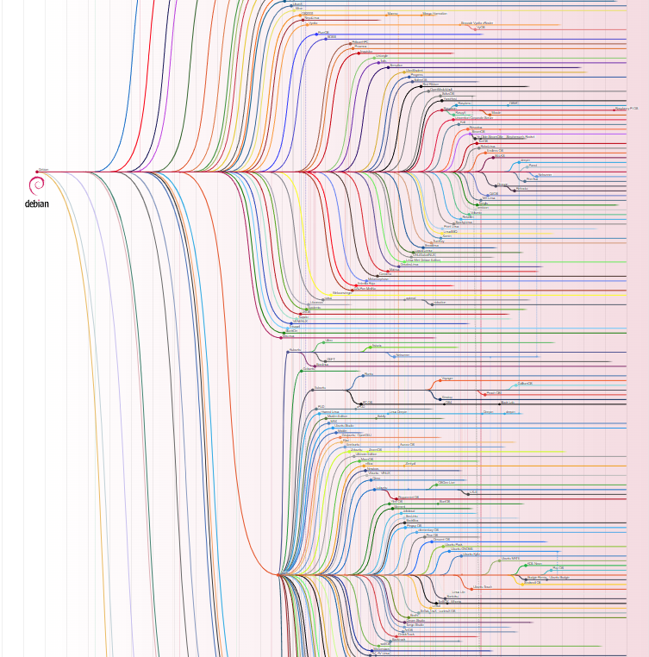
02
CENTER
// OUR
Development
// Group 4

Slide 8

//General Public License
GNU - GPL
GNU/Linux is not the only free and open-source operating system, although it is by far the most widely used.
Free software projects are often produced independently of each other, collected and available all at once in the form of a Linux distribution (Distro).
Linux Distros are created by individuals, groups, or companies and are free to download and install.

Slide 9
// Programing On Linux
C, C++
Java
C#
Python
PHP
Perl
Compiler
Interpreter
Code::Blocks
Eclipse
NetBeans
Vim, Nano, Emacs
VSCode, Atom
Sublime Text
IDE
Editor

Slide 10
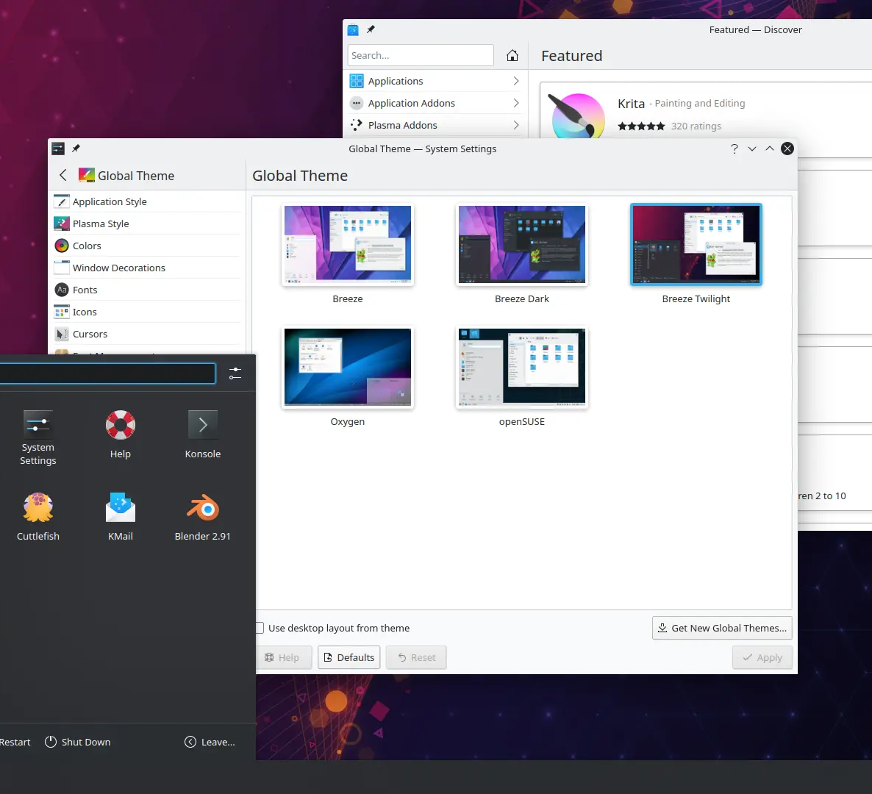
03
CENTER
// OUR
Uses
// Group 4

Slide 11
// INNOVATIONS
// Desktop/Laptop
User Interface
Desktop Environment
Window Manager
Command-Line Interface (CLI)
Graphical User Interface (GUI)
GNOME
KDE Plasma 5
Xfce
Mutter
KWin
Xfwm

Slide 12
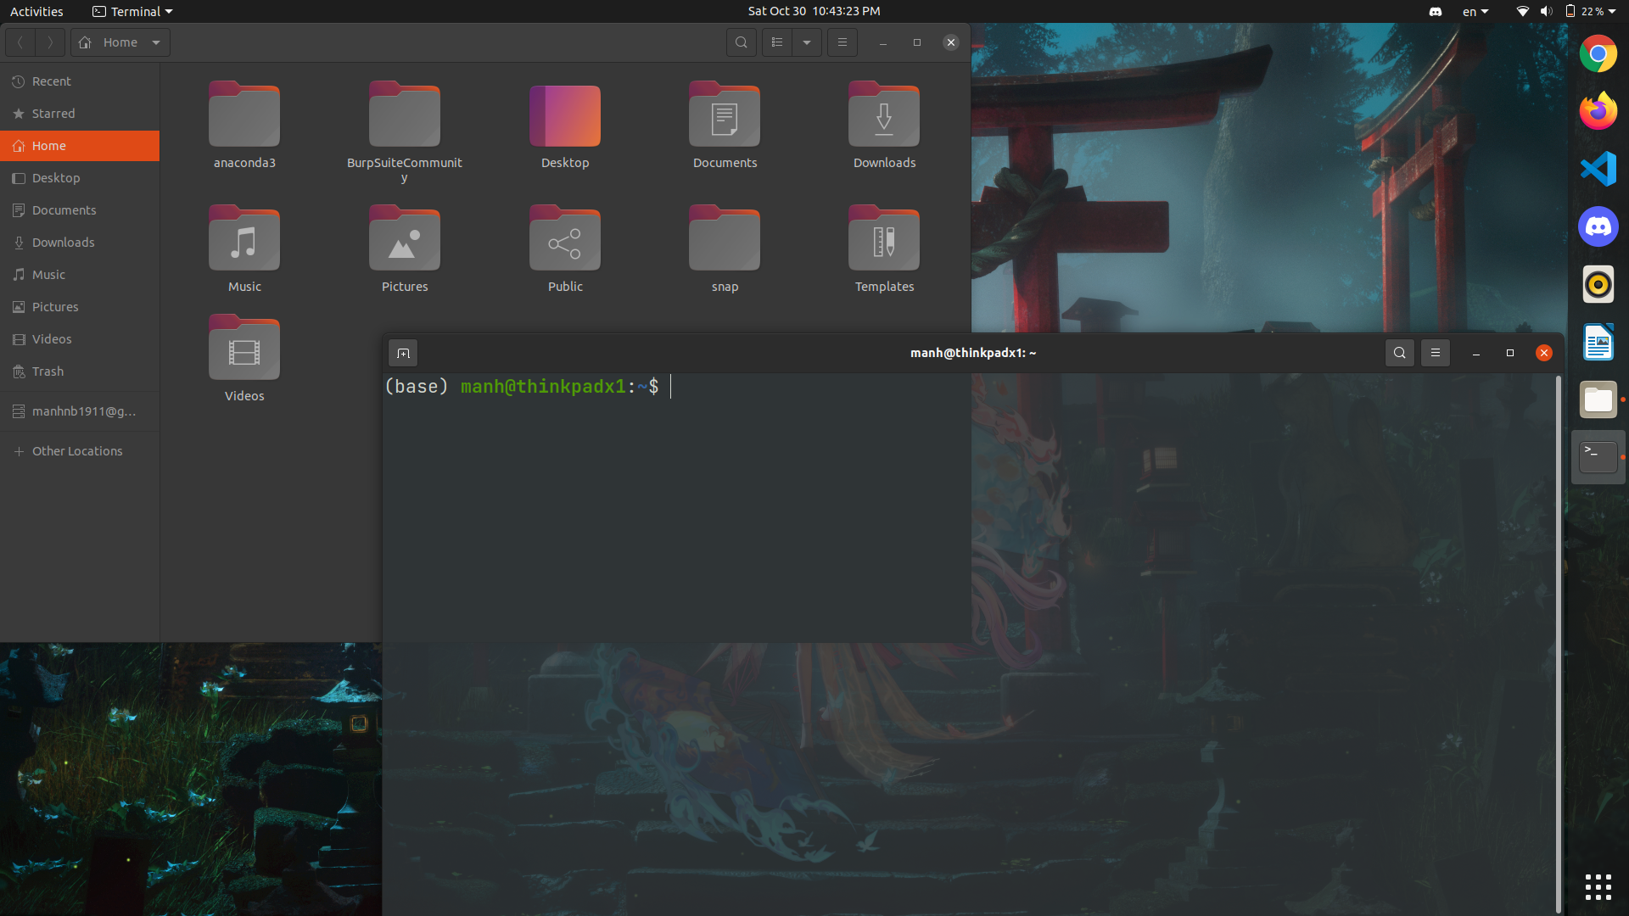

Slide 13
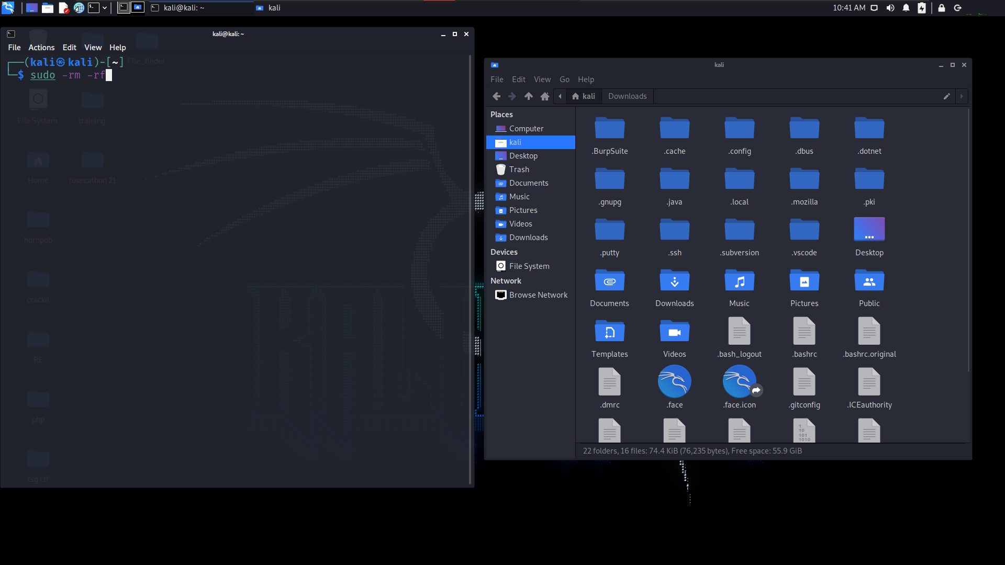

Slide 14
// Other Uses
Netbook
Smart Devices
Specialized Uses
Server, Mainframe, SuperComputer
Embedded Devices

Slide 15
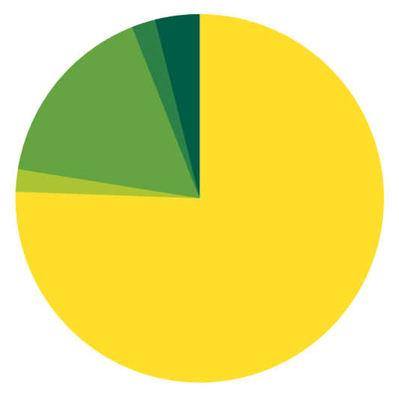
04
Market share and uptake
CENTER
// OUR
// Group 4

Slide 16
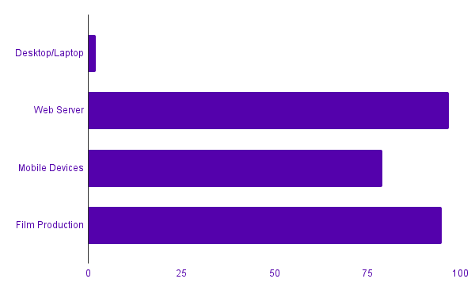
// Market share and uptake
Linux
Market Share
The Linux market is growing rapidly, and the revenue of servers, desktops, and packaged software running Linux was expected to exceed $35.7 billion by 2008.

